Slide 1
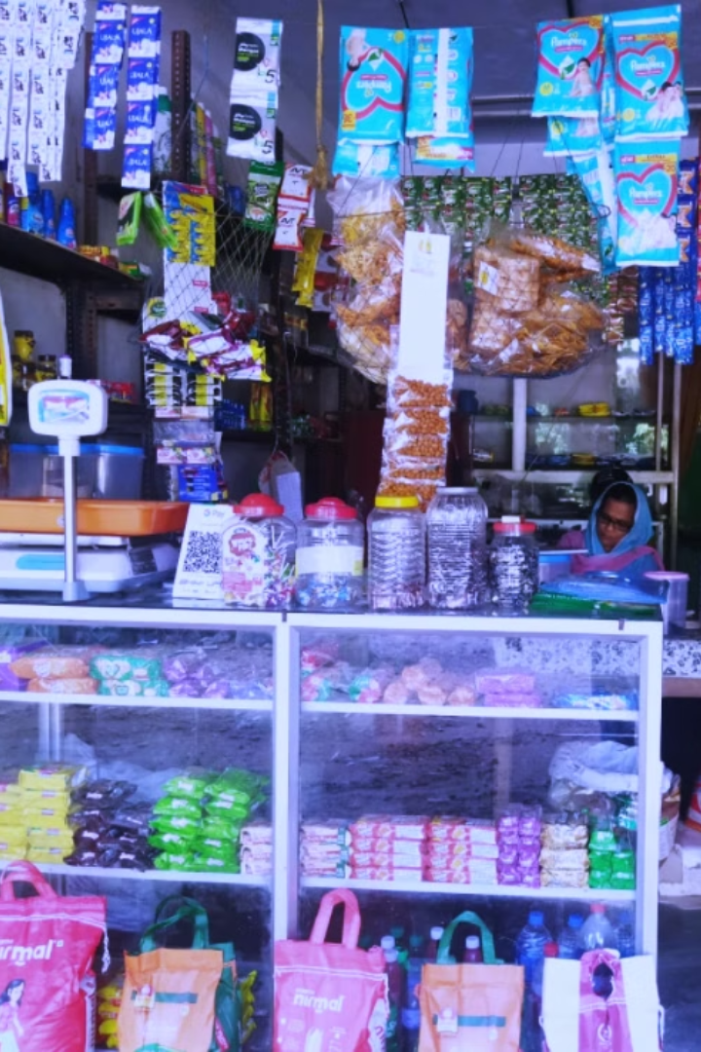
Sustaining a Small Kirana Store: Tackling Inventory and Profit Challenges
This presentation explores how Kochuparambil Stores, a 20-year-old Kirana shop in Kottayam, Kerala, can enhance profitability through data-driven sales strategies, optimized inventory management, and improved customer relationships for sustainable growth.
BDM Capstone Project By:
Irina Agastin
23f2004169@ds.study.iitm.ac.in

Slide 2




Challenges faced by Kochuparambil Stores
Demand Fluctuations
Low Profit Margins
Increased Competition
Addressing the fluctuating demand for items to stabilize inventory.
Tackling low profit margins after sales to enhance profitability.
Navigating increased competition in the vicinity to maintain market share.
Data-driven strategies and visual analysis will transform these challenges into actionable insights for Kochuparambil Stores, improving revenue, profits, customer engagement, and competitive positioning.

Slide 3
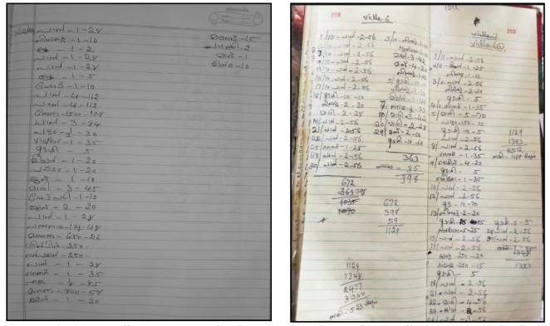
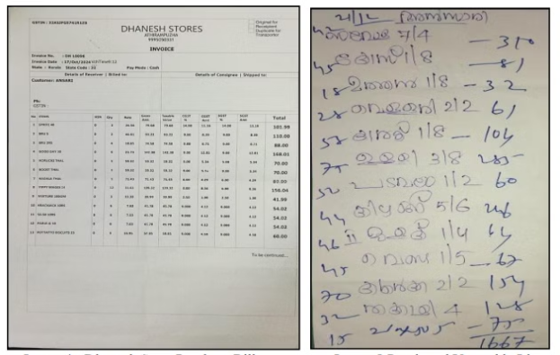
Data Collection and Preprocessing
Sales Data
Purchase Data
Sales data was collected from the owner's daily and monthly records, including details on item name, quantity, selling price, and customer payment mode. The data was then transferred to Google Sheets for structuring and analysis.
Purchase data, including item name, category, price, and quantity, was gathered from Dhanesh Stores' bills and handwritten lists from market vendors. This data was crucial for determining the cost price of each item for profit analysis
The unstructured data was transformed into a structured format using Google Sheets, employing functions like SUMIF, COUNTIF, and VLOOKUP. The shop's 128 items were organized into 10 categories based on their characteristics, enabling a clearer view of each category's contribution to store revenue and profit.

Slide 4
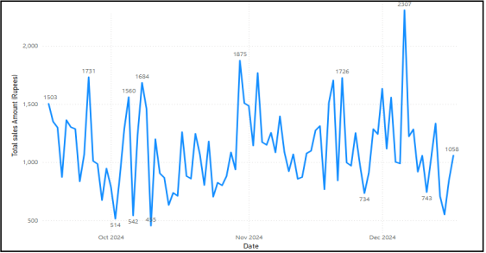
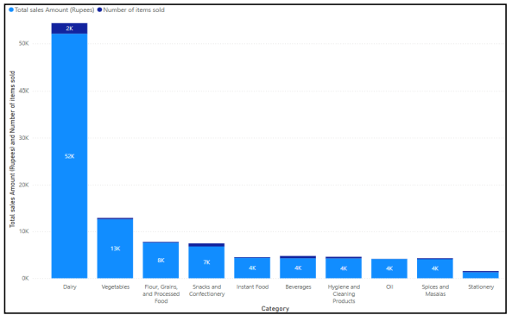
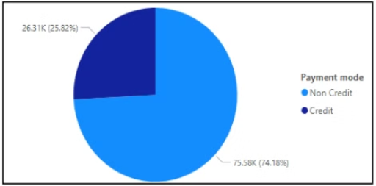
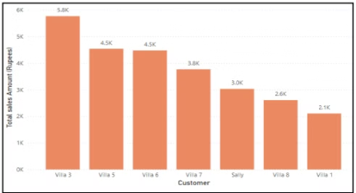
Revenue and Customer Analysis
Grouped 128 items into 10 Categories based on their characteristics:
Dairy
Vegetables
Flour and Processed
Snacks
Instant Food
Beverages
Daily Revenue Trend
Category-Wise Analysis of Total Sales and Number of Items Sold
Toiletries
Sales revenue shows high variability, with notable spikes in November and December, likely due to festive demand. Revenue drops on certain days may reflect slower sales periods.
Dairy products have the highest sales revenue (51% of total revenue) and the highest number of items sold, indicating strong demand. Vegetables rank second in total sales.
Oil
Spices
Stationery
The credit customers pay on a monthly basis.
Building strong relationships with these key customers can lead to long-term and sustained business growth.
Credit Customers
Key Contributors
Contribute more than 25% (Rs. 26,307) of the total revenue. Understanding the specific needs and preferences of these credit customers can help tailor services and offers to retain their loyalty.
Villa 3, Villa 5, and Villa 6 contribute the most among credit customers. Hence foster a deeper connection with these key customers.

Slide 5
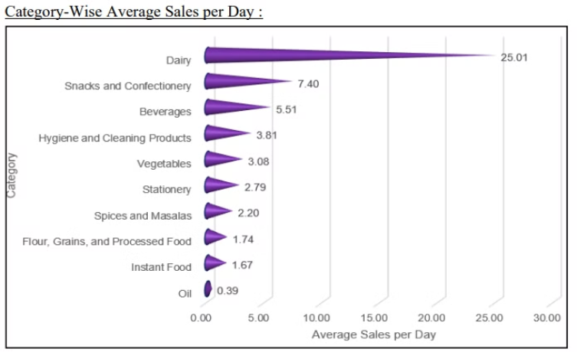
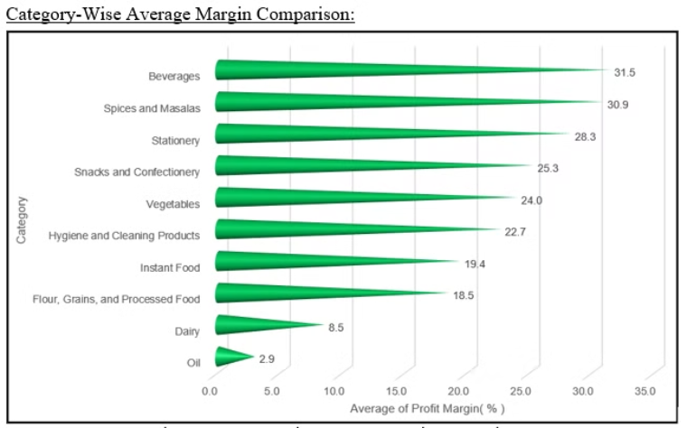
Detailed Product Analysis:
Milk - Product with the highest sales
86% of the Dairy category, with sales of Rs. 45,330.
Fast-Selling Categories
Dairy and Snack items are sold quickly. Milk is the fastest-selling product, with 17.8 units sold daily.
Highest Profit Margin
Products like Small onions, vinegar, matchsticks, and soda have high profit margins of more than 50%
Dairy products, especially milk, dominate sales. Oil and Instant Food items are sold at the lowest speed.
Although beverage products contribute less revenue than dairy products, they have the highest profit margin (31.5%), whereas dairy products generate the highest revenue but with a much lower profit margin(8.5%).

Slide 6
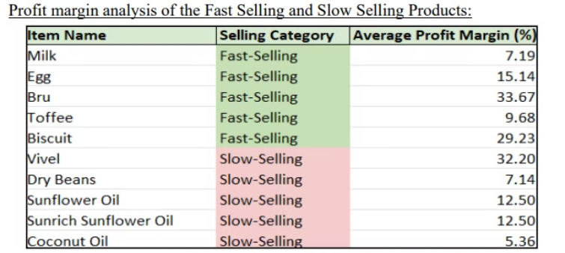
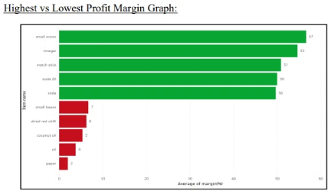
Profit Analysis: Margins and Contributions
High-Sales, Low-Profit
High-Sales, High-Profit
Milk and Toffee have high sales. However, their profit margins are low.
Bru and Biscuit have high demand. They offer substantial profit margins.
Low-Sales, High-Profit
Low-Sales, Low-Profit
Vivel has a significant profit margin (32.2%). But its sales are low.
Coconut Oil and Dry Beans have low sales and profit margins. They are the least profitable.
Recommendations
To increase profitability, it may be beneficial to focus on promoting products with high profit margins and boosting their sales volume. Targeting marketing efforts towards products like Bru and Biscuit could result in significant profit gains. Additionally, considering ways to enhance the visibility and appeal of lower-selling items with high profit margins, such as Vivel, could help improve overall profitability.
Also focusing on promoting products with high profit margins of more than 50% could significantly boost profitability.

Slide 7
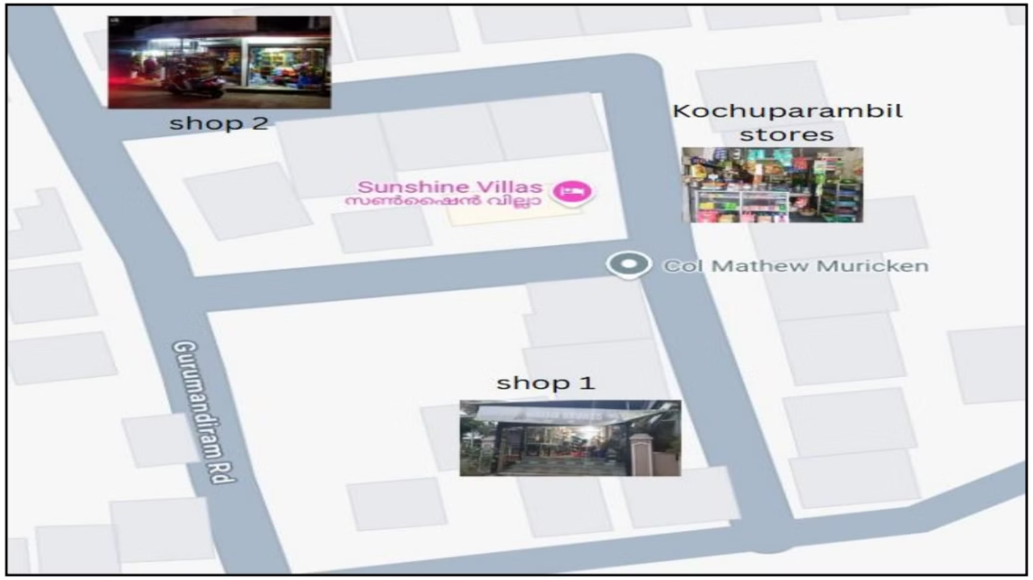
Competitor Analysis: SWOT Insights
Strengths
Weaknesses
Diverse product range, fast-moving products, visible snack stock, reliable milk supply, home delivery, and soft drinks.
Dependence on regular customers, limited demand for certain products, lack of fresh chicken, and no specialty items.
Opportunities
Threats
Expansion into specialty products, increased home delivery, visibility of niche products, and community engagement.
Competition from fresh products, price competition, less recognition, and customer loyalty shifts.
A SWOT analysis reveals the shop's strengths in variety and product freshness, weaknesses in customer dependence and limited product range, opportunities for expansion, and threats from competitors' offerings and pricing strategies.

Slide 8






Inventory Management and Product Diversification
Real-Time Tracking and Analysis
High-Margin Focus
Implement tools to track inventory in real time and regularly analyze sales data to adjust inventory planning.
Prioritize sodas for stock and visibility to boost its demand and overall profitability.
Strategic Promotions
Stock Planning for Fast-Selling Products
Optimize slow-moving inventory with seasonal offers, targeted discounts, or value packs (e.g., "Buy 1, Get 1 Free"), especially on high-sale days like Fridays. Negotiate with suppliers for returns or trade-offs to manage inventory effectively.
Ensure regular availability of high-demand items like milk and introduce complementary dairy snacks to boost sales. Implement stock planning to prevent shortages and meet customer demand efficiently
High-Visibility Shelving
Lemon Juice as a High-Margin Alternative to Soda
Place top-selling or bundled items like dairy products and complementary products at the front transparent shelves to attract customer attention and boost sales.
Replace soda with lemon juice to leverage higher margins and boost profits. Conduct market analysis to gauge consumer preference and diversify the product range for business growth.
Focus on high-margin products like sodas, implement real-time inventory tracking, analyze sales data regularly, and optimize slow-moving inventory with strategic promotions to improve overall profitability and reduce stockouts.

Slide 9
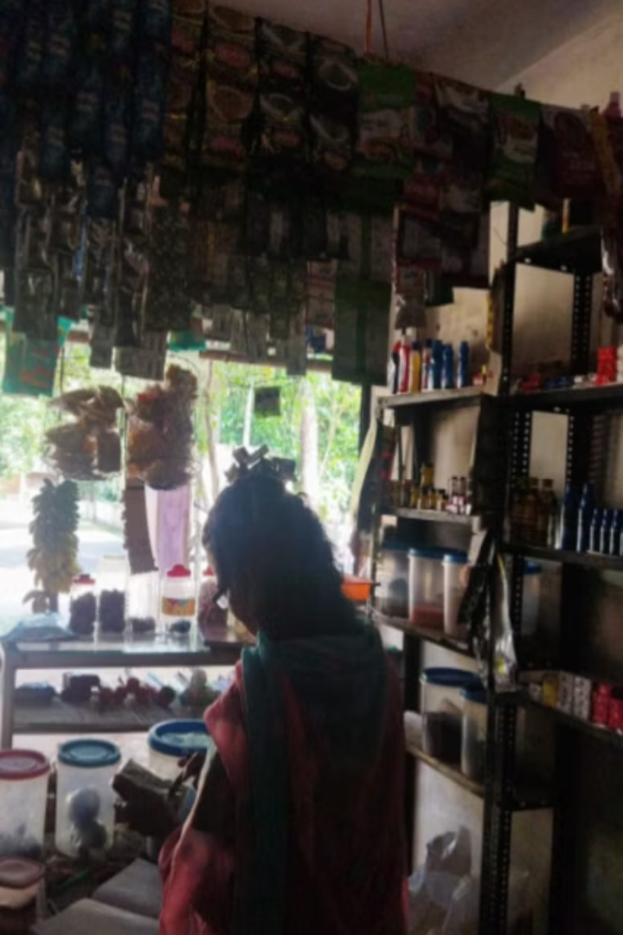






Financial Management and
Customer Engagement
Payment Adjustments
Dairy Agreements
Cost Management
Shift customer credit payments to every three weeks.
Negotiate weekly payments for dairy products.
Reduce purchase expenses and avoid over-purchasing slow-moving items.
Seasonal Campaigns
Home delivery
Boost Sales
Create customer groups for direct communication and orders.
WhatsApp promotions, festive offers, signboards, and seasonal deals
Offer festive-exclusive products and tailored offers.
Adjust customer credit payment schedules, negotiate weekly payments for dairy products, reduce purchase expenses, and offer festive and seasonal campaigns to improve cash flow, reduce costs, and enhance customer engagement.

Slide 10




Improvements and Future Growth
Differentiation
Offer unique products and home delivery.
Leverage local specialties or exclusive items to stand out from competitors
Quantitative Goals
Set specific metrics for improvement.
Track sales growth, customer retention, and inventory turnover regularly and introduce low-cost inventory tools
Sales Improvement
Implement combo offers and loyalty programs. Attract repeat customers and boost sales through rewards and promotional deals. Introduce curd, paneer, cheese, and replace soda with lemon juice or buttermilk to expand dairy options and attract health-conscious buyers.
Customer Surveys
Gather feedback for product diversification.
Analyze responses to identify new customer needs and trending products.
Offer unique products, set quantitative goals, introduce technology for inventory management, gather customer feedback, and engage with the community to enhance competitiveness and ensure long-term growth for Kochuparambil Stores.

